Slide 1
The Origins of Agile Software Development
A Module in Agile Fundamentals
Notes:
Hello, and welcome to The Origins of Agile Software Development, a module in Agile Fundamentals. This module is brought to you by ThoughtWorks Studios, makers of Mingle, Cruise, and Twist.

Slide 2
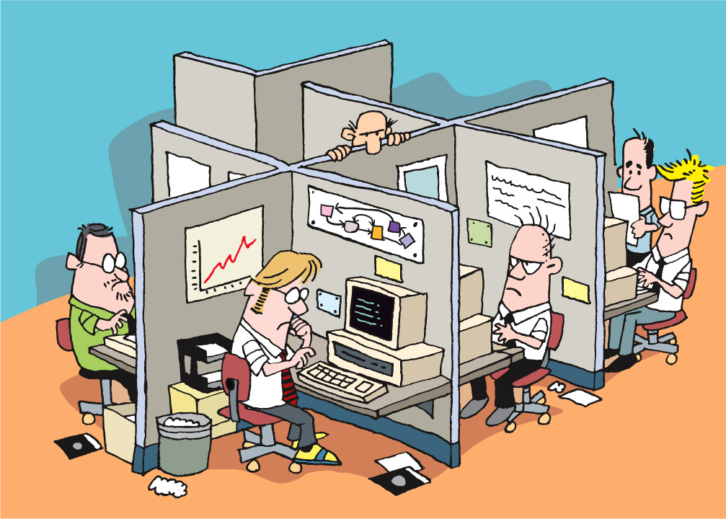
Notes:
In the beginning
Offices, cubicles, isolation
Strict hierarchy of roles – architects, designers, users, programmers, testers, PMs, BA, Build masters, tech writers
Rare to see crossover of specialties
Projects done in phases/stages.
One phase could not begin until the other was completed
[CLICK]
-------------------------------------------------------------------------------------------------------------
In the beginning, there were offices and cubicles and isolation and darkness. Those who created program code lived within a strict hierarchy, and were known as Architects, Designers, Users, Programmers, Testers, Project Managers, Build Masters, and Technical Writers. It was the rare individual who could cross over from one area of specialty to another. Growing into a more senior role, having more responsibility, required lengthy periods of apprenticeship and hardship. This was a system known as “Waterfall”. Projects were done in “phases” or “stages”, and no phase could begin until the preceding phase was done.
Imagine that you were a tester, back in those days. You’d spend weeks or months reading the specs, planning, organizing your thoughts, all in the service of being able to start your “real” work when the architects, designers, and programmers were done with their jobs. You didn’t really talk to the others all that much, because they had their heads down, busily doing their jobs in their phases. Interruptions were not welcome.
In order to accomplish anything requiring more than one person, a meeting would be called. People arrived late and unprepared. Resenting meetings, some people paid little attention and hurried to escape. Fortunately, back in those days, there were no notebook computers or iPhones, so those forced to attend meetings had nothing to distract them. Meetings tended to be focused around passivity – a presenter presented, and everyone else tried to stay awake. The ideas of participation and collaboration tended to be marginalized.
Imagine the times: massive computer terminals, hardwired to mainframes and “super-microcomputers”, running proprietary operating systems or UNIX. No PCs or Macs, no notebooks, no monitors and ergonomic keyboards, no mice. And no Internet! Truly the Dark Ages.
From the second slide:
Analysts
Spent weeks or months creating detailed specifications for an entire system
Developers
Individually estimated portions of the application
PMs
Planning to the nth detail
From the third slide:
Testers
Spent weeks or months reading specs
Planning, organizing your thoughts
So you could start when the architects, designers, developers were done
Heads down development
No talking to others regularly
Interruptions not welcome
[CLICK]
-------------------------------------------------------------------------------------------------------------
Imagine that you were a tester, back in those days. You’d spend weeks or months reading the specs, planning, organizing your thoughts, all in the service of being able to start your “real” work when the architects, designers, and programmers were done with their jobs. You didn’t really talk to the others all that much, because they had their heads down, busily doing their jobs in their phases. Interruptions were not welcome.
From fourth slide:
Meetings required to resolve issues, answer questions
People arrive late
Not focused
No iphones or laptops to distract back then
Passive meetings – presenter, listeners
Little collaboration, participation
Exaggerating to make a point

Slide 3
What Flavor of Agile?
Scrum
Crystal Clear
Extreme Programming (XP)
Adaptive Software Development
Feature Driven Development
Dynamic Systems Development Method (DSDM)
Lean Software Development
Notes:
Lots of different flavors of Agile, and we will take a look at a few of them very quickly (these are just a few)

Slide 4
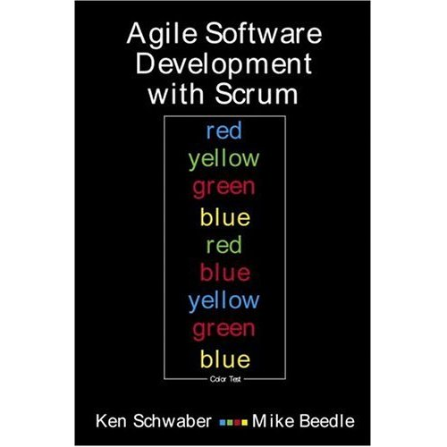
Scrum
Primarily a project management method
Project planning
Release planning
User Stories
Daily stand-up
Story points
Velocity
Notes:
Kent Schwaber developed in the late 1990’s
Approach to plan, monitor, and manage projects
Widely used

Slide 5

Extreme Programming (XP)
Primarily a developer-centric approach
Test Driven Development (TDD)
Unit tests
Pairing
Continuous Integration (CI)
Refactoring
Notes:
Kent Beck, also developed in late 1990’s
Primarily developer focused, although it shares many of the same beliefs as scrum for team dynamics and planning
Also widely used

Slide 6
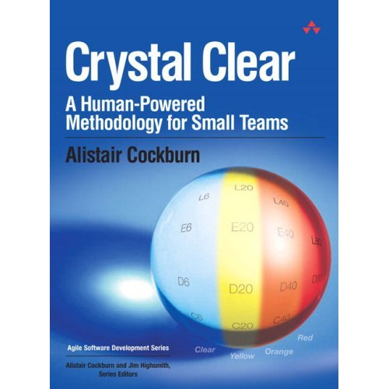
Crystal Clear
Focuses on people, not methods or artifacts
Teams of 6 to 8
Co-location
Reflective improvement
Team safety
Singular focus
Notes:
Alistair Cockburn
For non-critical, small-team, focused and dedicated development
Focuses on team dynamics, individual “belonging”, experimentation, allows failure

Slide 7

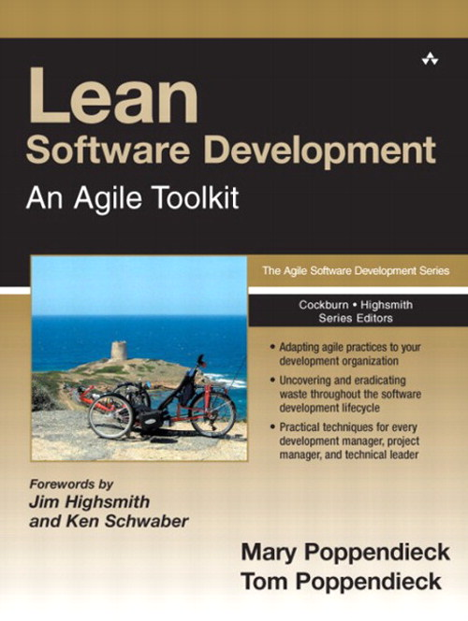
Lean Software Development
Optimize the whole
Eliminate waste
Build quality in
Learn constantly
Deliver fast
Engage everybody
Keep getting better
Notes:
Mary Poppendiek (“pop – en – dike”)
Grew out of manufacturing, primarily the Toyota Production System
Focuses on eliminating waste throughout the entire process, while building-in quality

Slide 8
So What?
Goal
Fundamentals
Ceremonies
Techniques
Iterations
User stories
Training
Co-location
Deliver high-value, high-quality working software quickly and frequently
Short feedback loops
Task cards
Project kick-off
Story board
Burn chart
Release planning
Grooming the backlog
Inspect and adapt
Iteration planning
TDD
Collaboration and teamwork
Planning poker
Daily stand-up
Done-done-done
Review / demo
Pairing
Unit tests
Retrospective
Participate
Continuous integration
Notes:
We combine the best elements of all agile approaches, so when we talk about “agile” it can mean a range of things.
But the focus is always the same – delivering business value effectively and quickly
Don’t be fooled into thinking that if you do all the things on the right that you are agile – if you are not delivering business value, you have lost the plot.

Slide 9
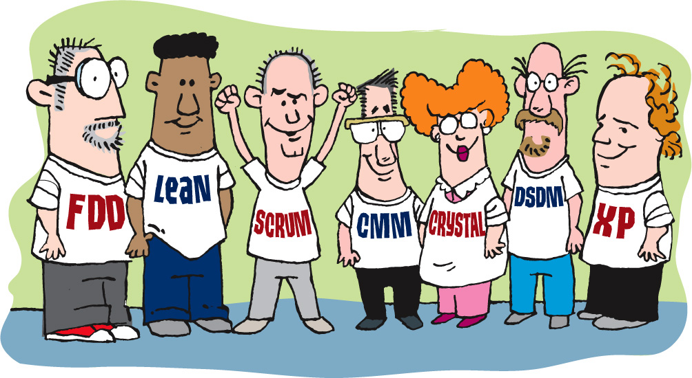

We Are Going to Look at:
Planning – project, release, and iteration (sprint)
Metrics
Pairing
Quality
The team and its organization
Executing through iterations (sprints)
Notes:
We will learn how to organize, start, and execute a project using agile, using those techniques and approaches that are most useful here, rather than being focused on any single agile methodology.
Need to be pragmatic, practical, and discover what works best

Slide 10

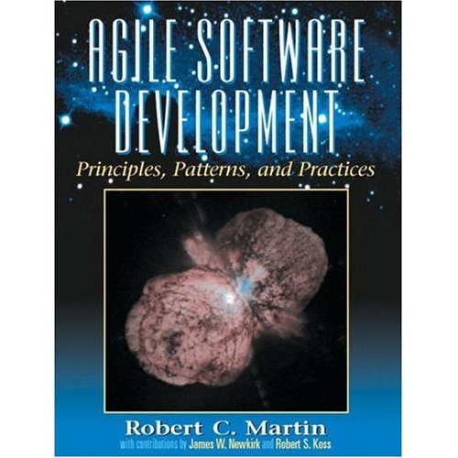
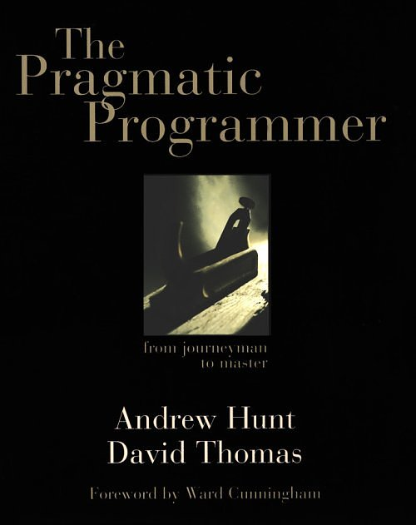


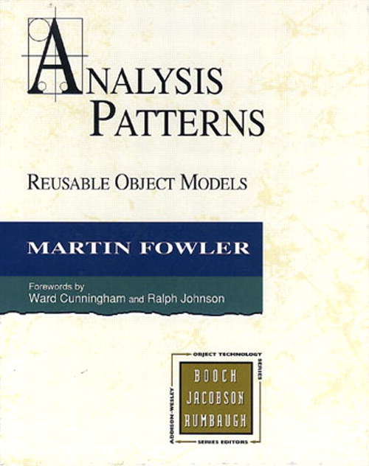
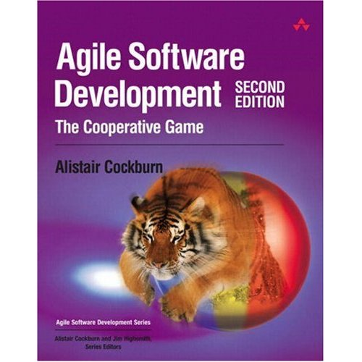

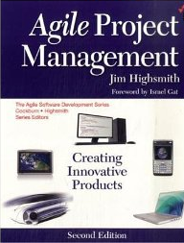

Notes:
There are lots of books on the subject of agile development, and you may want to reads some of them for yourself.

Slide 11
The Agile Manifesto
Following a Plan
Processes and Tools
Contract Negotiation
Working Software
Comprehensive Documentation
Individuals and Interactions
Customer Collaboration
Responding to Change
Notes:
Now for a little bit of fun. You each have a worksheet that contains the key concepts that make up the Manifesto. There’s a template on those worksheets, showing how the ideas go together. Let’s take a few minutes to see if we can figure out what the signers of the Manifesto had in mind.
Building the Agile Manifesto
Don't just simply present the agile manifesto. The students will learn more if they have an opportunity to build it. Ensure that your flip chart has the four empty slots for all the statements as well.
Hand out copies of the empty Agile Manifesto (see Student's Handout). Feel free to ask students to work together in pairs or individually. Explain the manifesto is used as a guide for values and that everything on the list is important and we're trying to understand what factors might influence the decisions we make.
Give them five minutes to fill out their form. Build up the manifesto based on everyone's input and discuss why one item appears on one side, and why they are trade offs.

Slide 12
Notes:
What do these ideas mean to us?
Something over something else
Not instead of
Both sides have value
Items on the right have value BUT
We value the left items more
-------------------------------------------------------------------------------
Let’s talk for a few minutes about the four key ideas these folks wrote into the Agile Manifesto, and what they mean to us.
First, we’ll consider the wording. Note that every one of these is phrased as something over something else. That’s not instead of or is better than. No, it’s over. That means that both sides of the statement have value, and that the folks who authored the Manifesto were expressing a preference for one over the other.
In fact, what you don’t see on this illustration is the sentence that comes after the four points in the manifesto: “That is, while there is value in the items on the right, we value the items on the left more. “
Now let’s look at them one by one…

Slide 13
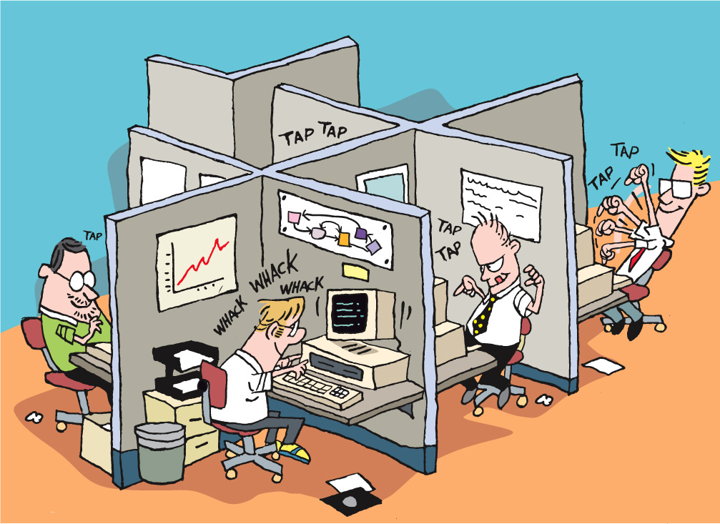
Notes:
Discussion:
How do you feel about getting out of your cubicles and moving to a teamroom environment?

Slide 14
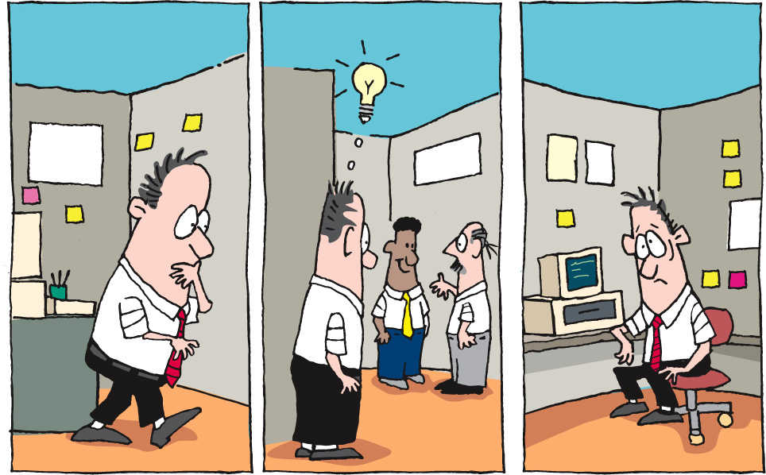
Notes:
Instead of getting up to find someone
Losing time and context
[CLICK]
Consider our previous example, where I have to get up, walk around, find someone to answer a question, go back to my office or cubicle, remember what they said… Well, there’s a lot of time and knowledge lost, and productivity is not very high. What if, when I wanted to ask someone a question, they were right there in the room with me? What if I could just ask, immediately use the answer, ask clarifying questions, all without leaving my work space?

Slide 15
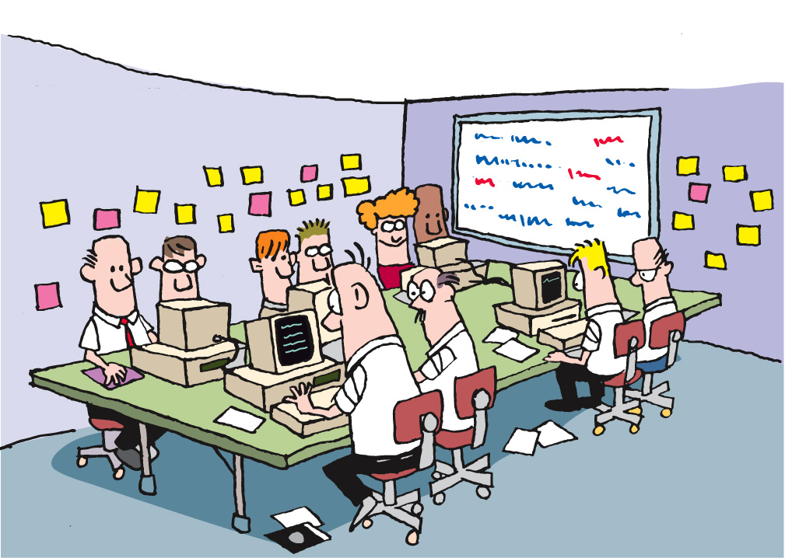
Notes:
I just pick my head up and ask the question
Get an answer
Follow up question
Back to work
Productivity goes up
Quality goes up
Time goes down
What about code reviews?
Long after the code was written, tested
Change was resisted
Feedback taken as criticism
What if my reviewer was working with me?
Talking to me while I code
Pairing with me
-------------------------------------------------------------------------------------------------------------------------
The answer is that productivity goes up, the quality of the work goes up, and the time it takes goes down.
Now, let’s look at another part of this. In the old days (yes, we’re still talking about times as recent as yesterday), code reviews were a separate process, conducted with some degree of formality. They usually took place after I’d written and tested my code, when I thought I was done, and when I thought I was ready to move on. Because we had to schedule and arrange and plan the time, code reviews frequently took place some significant time after I thought I was done. Changes were resisted, and feedback was always taken as criticism.
What if code reviews were happening in real time? What if my reviewer was actually sitting right next to me, talking to me about my code, the decisions I’m making, and so on, as I’m writing my code? And what if we changed roles periodically? This is Pair Programming, and is another outcome from the C3 project, and a core practice in XP.

Slide 16
Questions?
Agile Core
Notes:
What we’ve done……
Seen how best practices address traditional project challenges
Learned the process
Met the team

